Slide 1
Abstract
By Prof. Neha P. Rajas
VIT, Pune

Slide 2
what is an abstract method
In terms of object-oriented programming, abstraction means that you hide a few unnecessary details of implementation from a user.
This, in turn, leads to a better focus on the essential details or functionality.
This also increases the overall efficiency and thus reduces complexity.
Once you understand what is an abstract method, you can better understand what an abstract class is as well.

Slide 3
Abstract methods in java
Abstract methods in java mean those methods that stand declared with the usage of abstract keywords inside an abstract class.
These do not have any definition per se and thus, are called abstract methods in Java.

Slide 4
Abstract class in java example
Abstract class in java example can be best defined as a subclass responsibility without any implementation in super class.
This is why any subclass needs to override the same for providing a method definition.
The best way to understand abstract class in java example is to understand that abstraction will be achieved with the use of abstract classes as well as methods.

Slide 5
What Abstract Class Contains?
A class stands declared as abstract on using an abstract keyword. This may have zero or more methods that are abstract or non-abstract.
We must extend what an abstract class contains and then implement the methods. Instantiation isn’t possible.
The keyword “abstract” is used for abstract classes and methods in Java. The abstract class has the abstract keyword in its declaration.

Slide 6
The syntax of a Java abstract class is:
abstract class class_name
{
public abstract void the_abstractMethod();
public void the_normalMethod()
{
#body of the method
}
}
The above syntax shows that both normal and abstract methods can be contained in an abstract class.

Slide 7
Top Features Of Abstract Class
Code reusability
Template
Loose coupling
Abstraction
Dynamic resolution

Slide 8
There are five important rules you must follow when using abstract classes in Java. These are listed below-
The keyword “abstract” must be used mandatorily when declaring an abstract class in Java.
Abstract class cannot directly get instantiated.
Abstract class needs to have at least one method that is abstract. An abstract class always contains final methods.
Such classes might also comprise non-abstract methods.
Abstract class might comprise constructors as well as static methods

Slide 9
Abstract methods
Abstract methods are those types of methods that don’t require implementation for its declaration. These methods don’t have a body which means no implementation. A few properties of an abstract method are:
An abstract method in Java is declared through the keyword “abstract”.
While the declaration of the abstract method, the abstract keyword has to be placed before the name of the method.
There is no body in an abstract method, only the signature of the method is present.
An abstract method in Java doesn’t have curly braces, but the end of the method will have a semicolon (;)

Slide 10
Example of an abstract method
public abstract class Car
{
private String model;
private String color;
private int year;
public abstract double computePrice();
}

Slide 11
A few cannot be used with the abstract keyword in Java
final
abstract native
abstract static
abstract private
abstract synchronized
abstract strictfp

Slide 12
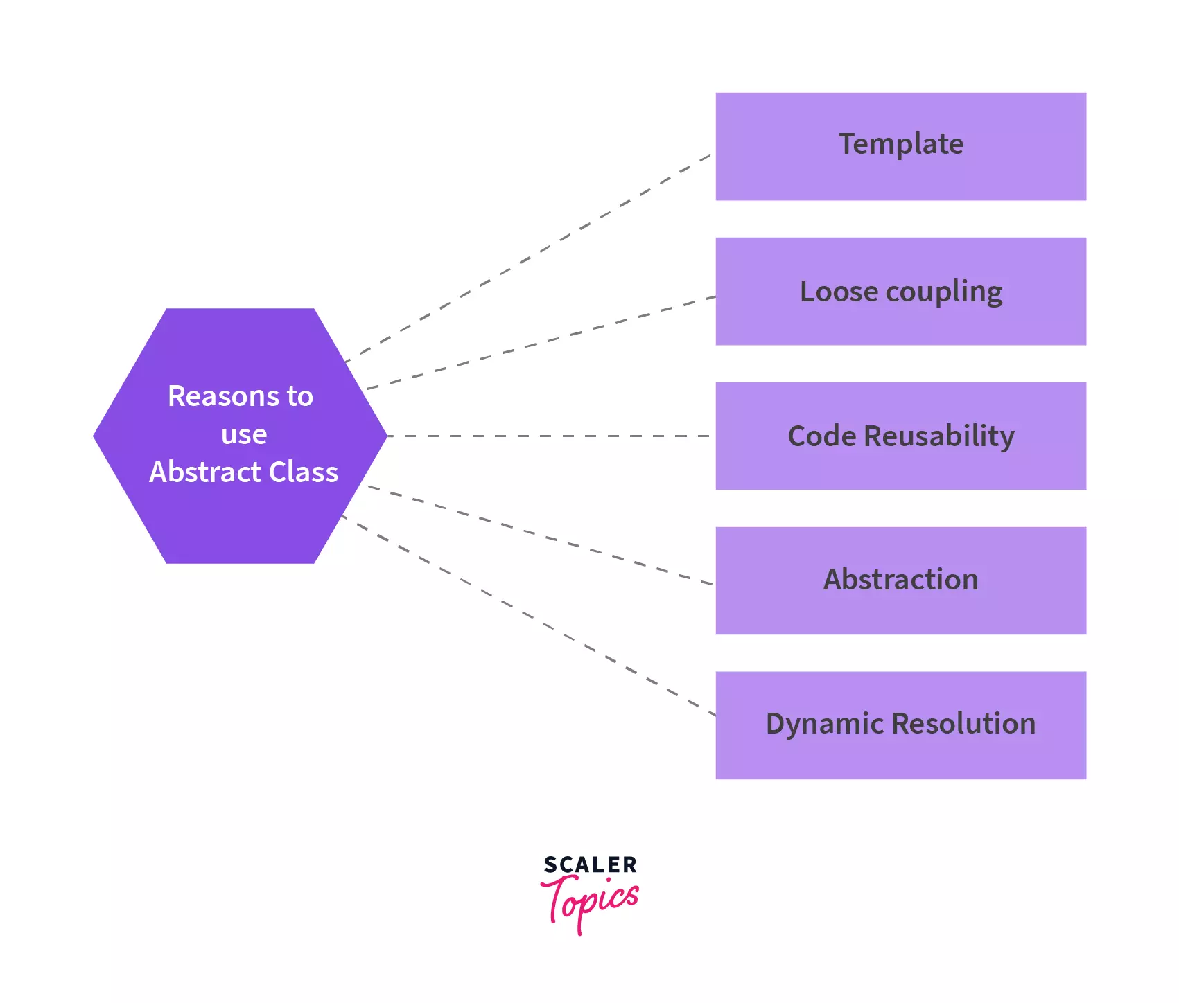
Need of Abstract class in java

Slide 13
example
abstract class Calculator
{
abstract void display();
}

Slide 14
class Add extends Calculator
{
void display()
{
System.out.println("In the Add Child Class");
}
}

Slide 15
class Sub extends Calculator
{
void display()
{
System.out.println("In the Sub Child Class");
}
}

Slide 16
class AbstractMethodExample
{
public static void main(String arg[])
{
Calculator add = new Add();
add.display();
Calculator sub = new Sub();
sub.display();
}
}

Slide 17
output
In the Add Child Class
In the Sub Child Class

Slide 19
Interface

Slide 20
What is an interface in Java?
The interface is a way to achieve abstraction in JAVA. An interface can have methods and variables like class, but the methods of an interface are by default abstract methods. It means the interface can contain only an abstract method(Method without body). The interface is used when we want to achieve full abstraction. After java 7, we can have default methods in the interface that were introduced in java 8.

Slide 21
An interface is a blueprint of a class and specifies what a class must do and not how to do it. The interface has only the abstract methods, when any class implements the interface then it must provide the body of abstract methods.
If a class implements an interface and doesn’t provide a body to the abstract method, then the class must be declared abstract otherwise it will throw compile time exception.

Slide 22
Properties of an interface
An interface is declared with the interface keyword.
2. The implements keyword is used by the class to implement the interface.
3. Before Java 8, An interface can have only abstract methods.
It can’t have concrete methods (non-abstract methods).
Since Java 8, an interface can have default methods and static methods. Since Java 9, an interface can have private methods.
4. All the interface methods are by default abstract and public.
5. An interface may also contain variables. All the variables are by default public, static , and final.

Slide 23
6. An interface variable must be initialized at the time of declaration otherwise compiler will throw an error.
7. You can’t create an object of the interface.
8. An interface does not contain any constructor.
9. An interface can extend by another interface. A class can’t extend the interface. A class can implement it.
10. The implementation class has the responsibility to provide a body of all abstract methods else the class should be an abstract class.
11. An interface can’t be declared as private, protected, or transient.

Slide 24
12. A class can implement any number of interfaces by use of the comma.
13. A class cannot implement two interfaces that have methods with the same name but different return types.
14. By the use of inheritance, we can achieve multiple inheritances which are not possible by the use of the class.

Slide 25
How to create an interface
An interface is declared by using the interface keyword. An Interface looks like a class except for the interface keyword. During the declaration of the interface, we must take of methods because it can have only abstract methods(Method without body). But after Java 8 we can define the default method in interface. We can define variables also in the interface.

Slide 26
example
interface StudentData
{
int rollNo = 1;
int marks = 79;
void showData();
void showDetails();
}

Slide 27
interface: It is a keyword that is used to declare an interface. variable: You can declare variables in the interface. The variables are public, static and final by default. abstract method: You can declare a method in the interface. All the methods declared in the interface are public and abstract by default.

Slide 28
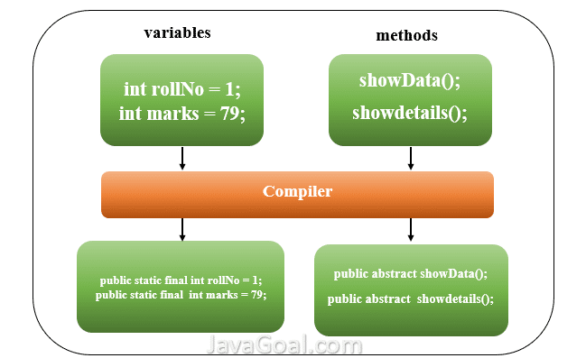
How does the compiler work after the declaration of the interface?

Slide 29
How to implement an interface?
As you have read the interface is used to achieve abstraction like an abstract class. We can’t create an object of the interface. To provide the body of abstract methods, we can implement interfaces in other classes.
When a class implements an interface, it uses the implements keyword. By use of the implements keyword all the variables and methods are inherited in class.

Slide 30
interface Student
{
// variable in interface
int rollNo = 1;
int marks = 79;
// methods in interface
void showData();
void showDetails();
}

Slide 31
class Marksheet implements Student
{
@Override
public void showData()
{
System.out.println("This is implementation of show method");
}
@Override
public void showDetails()
{
System.out.println("Rollno = "+ rollNo + " and marks of student = " + marks);
}
}

Slide 32
public class MainClass
{
public static void main(String arg[])
{
Marksheet marksheet = new Marksheet();
marksheet.showData();
marksheet.showDetails();
}
}

Slide 33
Output:
This is implementation of show method Rollno = 1and marks of student = 79

Slide 34
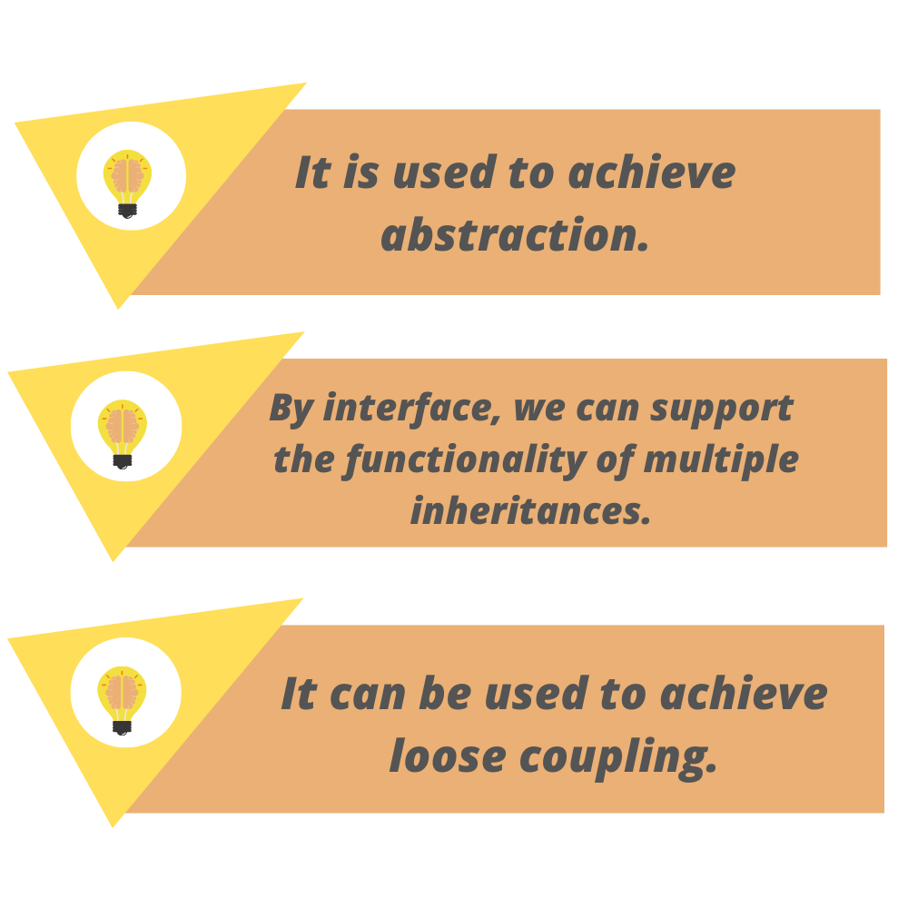
Use of interface

